Slide 1

Generics
Lecturer
Rokas Slaboševičius
Data

Slide 2
Today you will learn
Generics
What is Generics
01
How to create Generic classes/methods
02
How to use Generic classes/methods
03

Slide 3
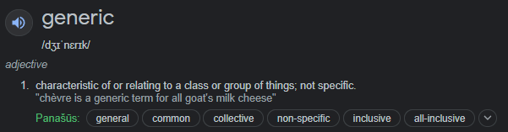
What is Generic?
Generics
Non-data type specific/non-data type specific functionality

Slide 4
Generics
"To decouple data type from logic"

Slide 5
The List collection is "generic". Why?
Generics
When we create a List, we specify the data type from which the List will be built.
The List collection does not strictly specify the type of data from which it can be built
For example: var listOfStrings = new List<string>();
List<string> - we specify the type of the list, which means that within the List functionality, the logic is programmed so that the list can be composed of any data type and we specify the type to be used when initializing.
We can also create a List<Human>.

Slide 6
T type parameter
Generics
T type is used to indicate that the functionality you are developing will allow you to specify the type you want.
For example:
ShowItem<T> (T item)
This is how I specify that when calling the ShowItem function, you will need to specify the data type of the variable to be passed to the parameters.
For example: showItem<string>("Name");
ShowItem<int>(5);

Slide 7



T type parameter
Generics
As you can see, when we call the ShowItem function we specify which data type
we want to use and pass a variable of the specified data type to the parameters.

Slide 8



T type parameter
Generics
Another example would be creating a function that returns
the type of generic variable passed.

Slide 9
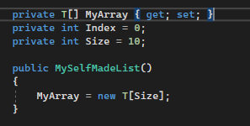
T type parameter
Generics
We create our equivalent of List, which will be a class that we create to specify the data type of what the list will consist of and to add additional elements to it
The first parameter is T[] MyArray, which is a simple array type variable, but its type is T.

Slide 10
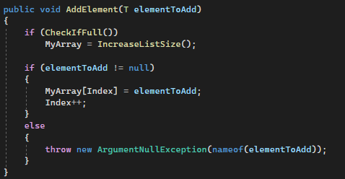
T type parameter
Generics
To add an item to your list, you need to create a public function
In this case, it looks like this:
The most important thing is to pay attention to the parameters.
the type of the elementToAdd parameter is T
This means that when calling this function, you need to specify the same
the data type you specified when you initialised this object.

Slide 11

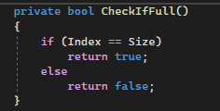
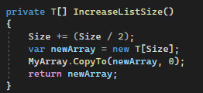
T type parameter
Generics
Since the size of the array is fixed, when creating your own generic List functionality, you need to create an incrementing array when it is full.
The CheckIfFull function only checks if the index is the same size
as well as the size of the array, which means that the array is full.
If the array is full, the function T[] IncreaseListSize() is called
Note that the return type of this function is T[]
The purpose of this function is to rebuild an existing array into a larger one while keeping the existing values

Slide 12
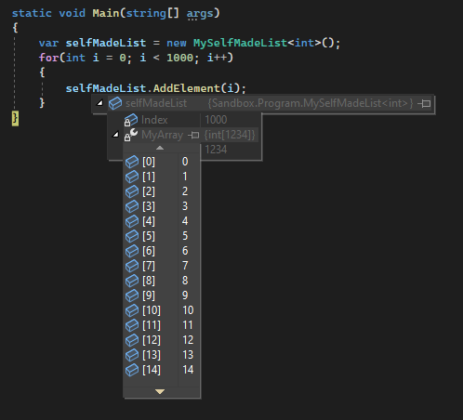
T type parameter
Generics
As you can see, we have an object of our own creation that is very similar to the List<T> collection.
It would also be possible to create functionality to delete an item.

Slide 13
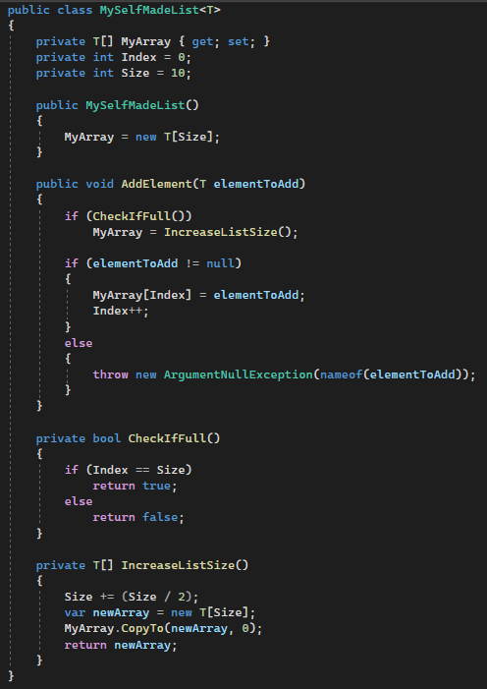
T type parameter
Generics

Slide 14

Generics
Task 1
Create a generic class Validation that has a function called Validate
The purpose of the validate function would be to check whether the passed parameter is null
If it is null it will throw an error.

Slide 15
Generics
Task 2
Modify the program of the first task so that the Validation class does not need to be initialized
It would be possible to simply call the method in Validate
E.g. Validation.Validate<string>(null);

Slide 16
type T vs Object
Generics
How these functionalities differ:
List<T> and List<object> ?

Slide 17
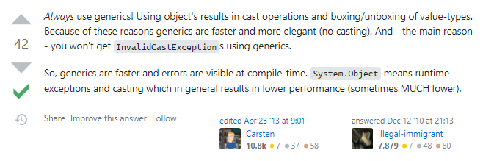
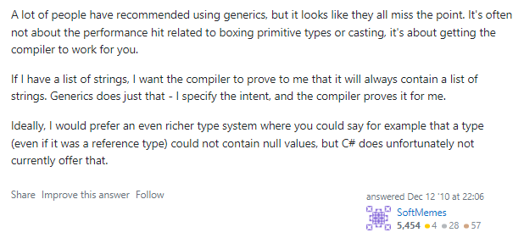
type T vs Object
Generics
url: https://stackoverflow.com/questions/4424030/c-system-object-vs-generics

Slide 18
Generics
Task 3
Type T parameters can be specified in more than one, e.g. ShowValues<T1, T2>
Create a function that asks for 2 generic types
Takes 2 variables via parameters, one of the first generic type, the second of the second generic type
They are both printed to the console.
When calling these functions, pass different types.

Slide 19
Generics
Task 4
Extend the MySelfCreatedList sample class with a method to delete an item from an array.

Slide 20
Lecture title
Generics
https://docs.microsoft.com/en-us/dotnet/csharp/fundamentals/types/generics
https://www.youtube.com/watch?v=VP8nAeYxHfs&ab_channel=.NETInterviewPreparationvideos
Useful information

